Slide 1
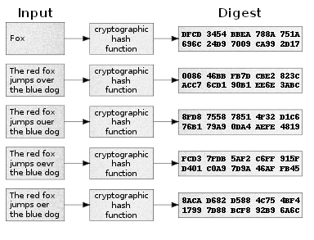
Cryptographic hash function
Mathematical algorithm that maps data of arbitrary size (often called the "message") to a bit array of a fixed size

Slide 2
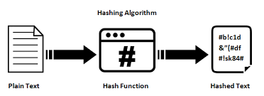
Cryptographic hash function
Features
it is deterministic, meaning that the same message always results in the same hash
it is quick to compute the hash value for any given message
it is infeasible to generate a message that yields a given hash value (i.e. to reverse the process that generated the given hash value)
it is infeasible to find two different messages with the same hash value
a small change to a message should change the hash value so extensively that the new hash value appears uncorrelated with the old hash value

Slide 3
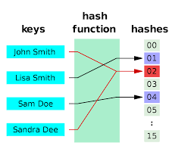
Cryptographic hash function
Deterministic
A hash procedure must be deterministic—meaning that for a given input value it must always generate the same hash value.
It must be a function of the data to be hashed, in the mathematical sense of the term.

Slide 4
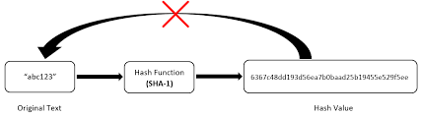
Cryptographic hash function
Irreversible
It is impractical to regenerate the input from the output.
A hash function should be a one-way function
Also called pre-image resistance

Slide 5
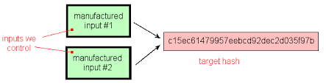
Cryptographic hash function
Second Pre-image resistance
Given an input m1, it should be difficult to find a different input m2 such that hash(m1) = hash(m2).
This is a type of collision resistance or second pre-image

Slide 6
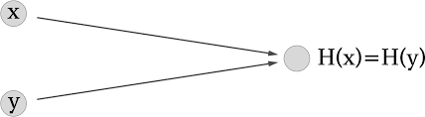
Cryptographic hash function
Collision Resistance
It should be difficult to find two different messages m1 and m2 such that hash(m1) = hash(m2).
This property is sometimes referred to as strong collision resistance.

Slide 7
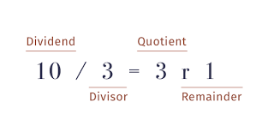
Cryptographic hash function
Modulo operator is the simplest hash function
The modulus operator - or more precisely, the modulo operation - is a way to determine the remainder of a division operation. Instead of returning the result of the division, the modulo operation returns the whole number remainder

Slide 8
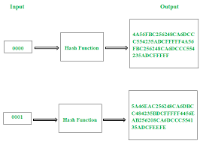
Cryptographic hash function
Avalanche Effect
The avalanche effect is the desirable property of hash algorithms.
If an input is changed slightly (for example, flipping a single bit), the output changes significantly (e.g., half the output bits flip).
Also called the diffusion

Slide 9
Cryptographic hash function
Popular Hash Algorithms
MD5 | MD5 message-digest algorithm is a widely used hash function producing a 128-bit hash value. Although MD5 was initially designed to be used as a cryptographic hash function, it has been found to suffer from extensive vulnerabilities. It can still be used as a checksum to verify data integrity, but only against unintentional corruption.
SHA-1, SHA-2, SHA-3 | NIST Standards. - SHA- 1 (1993), SHA-2 (2003) SHA-3 (2015) SHA-1 produces a hash digest of 160 bits (20 bytes). The output size in bits is given by the extension to the "SHA" name, so SHA-224 has an output size of 224 bits (28 bytes). based on a sponge construction which can also be used to build other cryptographic primitives such as a stream cipher. SHA-3 provides the same output sizes as SHA-2: 224, 256, 384, and 512 bits
RIPEMD-160 | RIPE (RACE Integrity Primitives Evaluation) in 1992. Typically represented as 40-digit hexadecimal numbers
BLAKE | Faster, optimized with changes in from SHA1, MD5 etc

Slide 10
Cryptographic hash function
Demonstrate SHA256 use in the javascript tool

Slide 11
Cryptographic hash function
Demonstrate a Simple Hash development in javascript

